Slide 1

SUBJECT CODE:18MAB102T
ADVANCED CALCULUS
AND
COMPLEX ANALYSIS

Slide 2
Applications of complex analysis

Slide 3
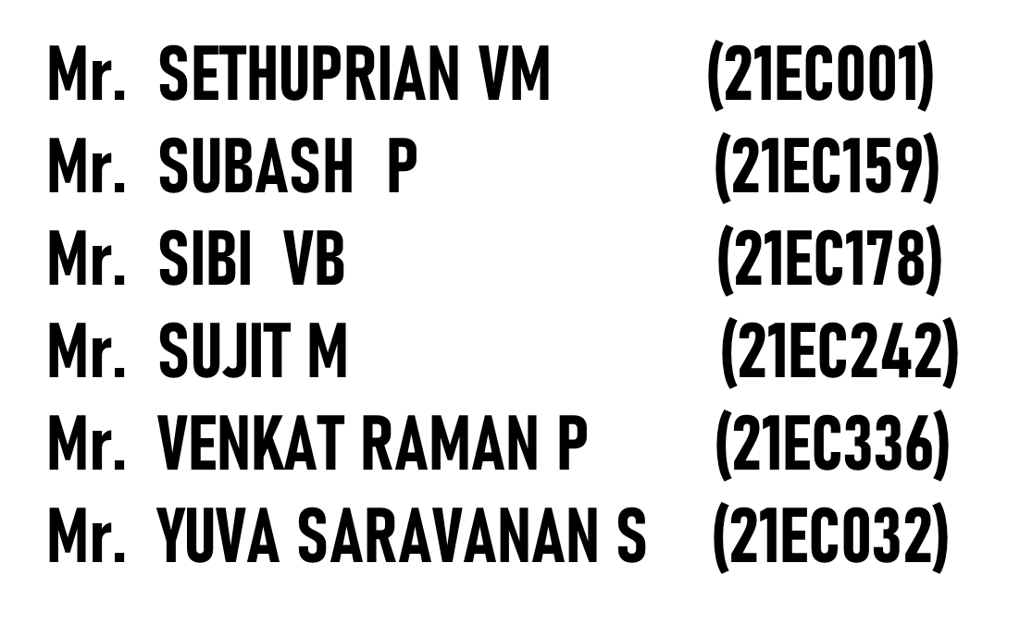

TEAM MEMBERS
(21BEC193)
(21BEC213)
SUBASH S
(21BEC214)
(21BEC221)
(21BEC238)
(21BEC248)

Slide 4
SYNOPSIS:
1.Introduction
2.What is complex number
3.Operations on complex number
4.Graphical representation of complex number
5.Importation of complex number
6.Applications of complex number

Slide 5
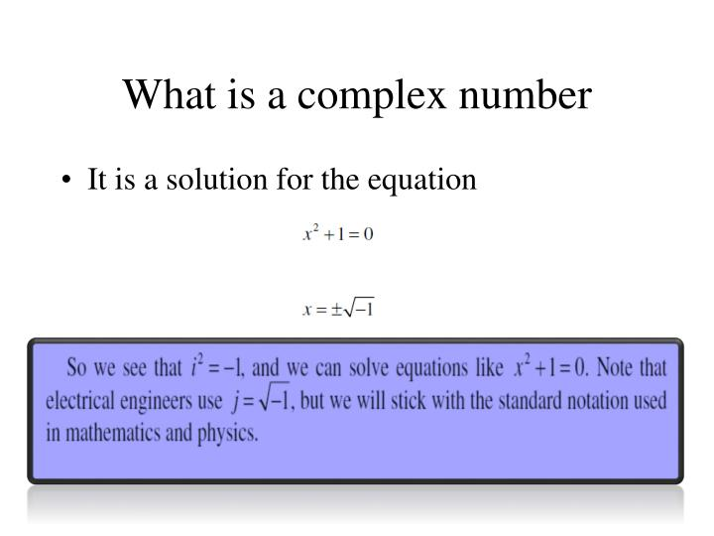

Slide 6
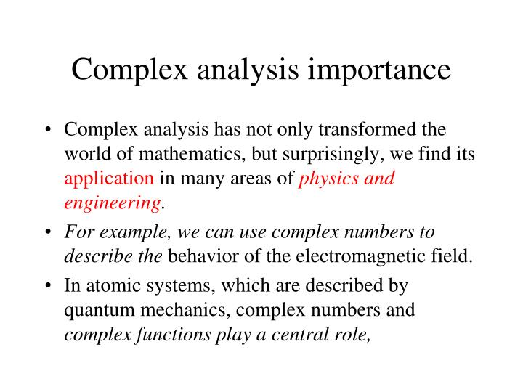

Slide 7
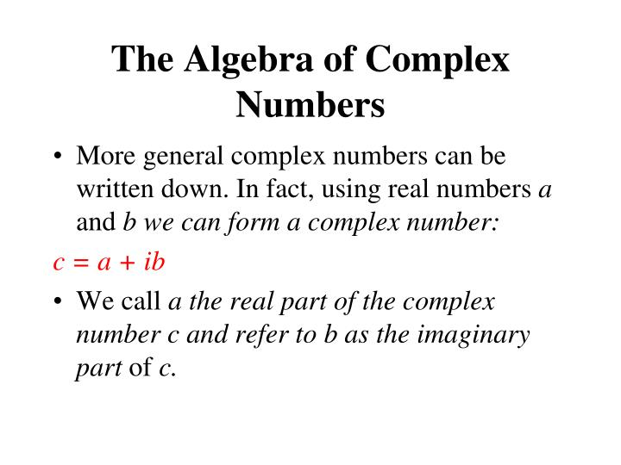

Slide 8
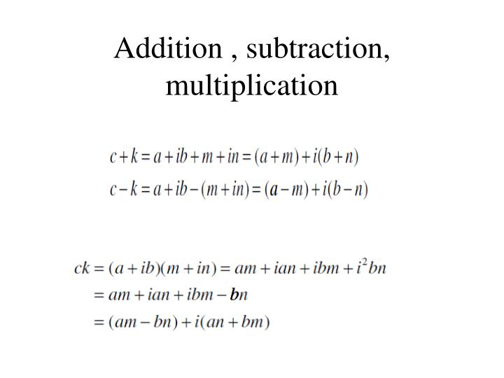
Operations of complex number

Slide 9
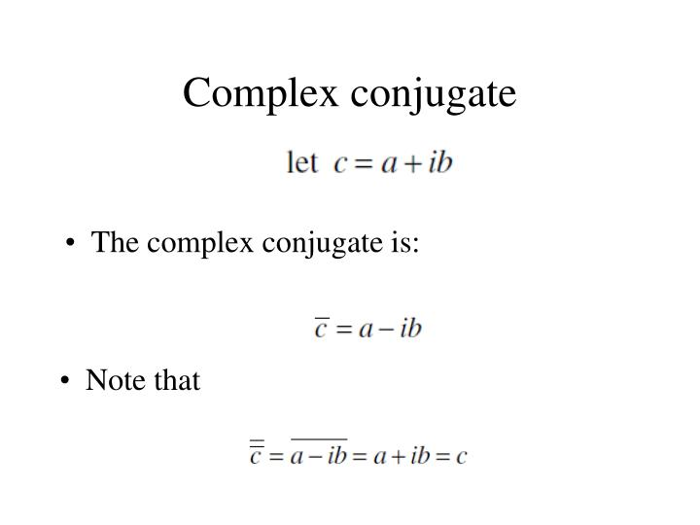

Slide 10
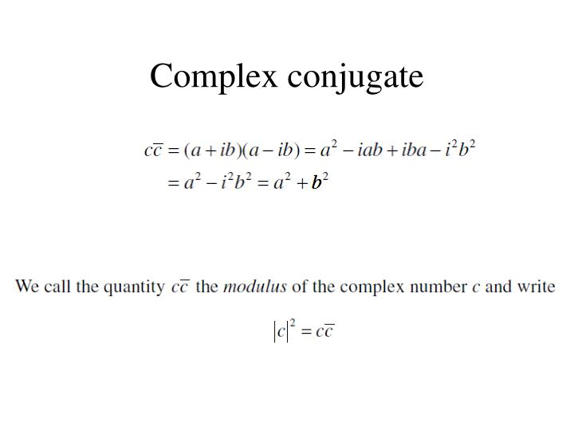

Slide 11
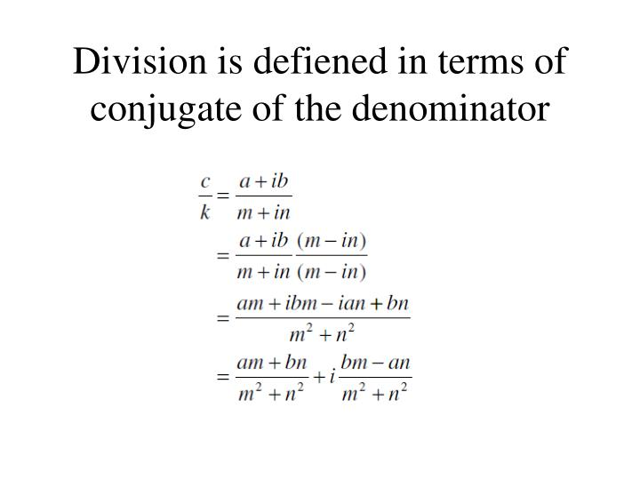

Slide 12
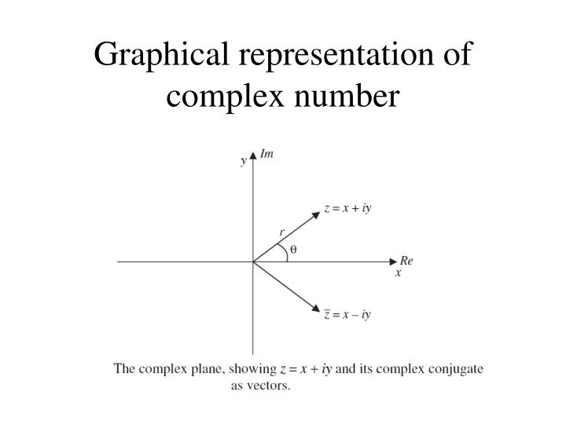

Slide 13
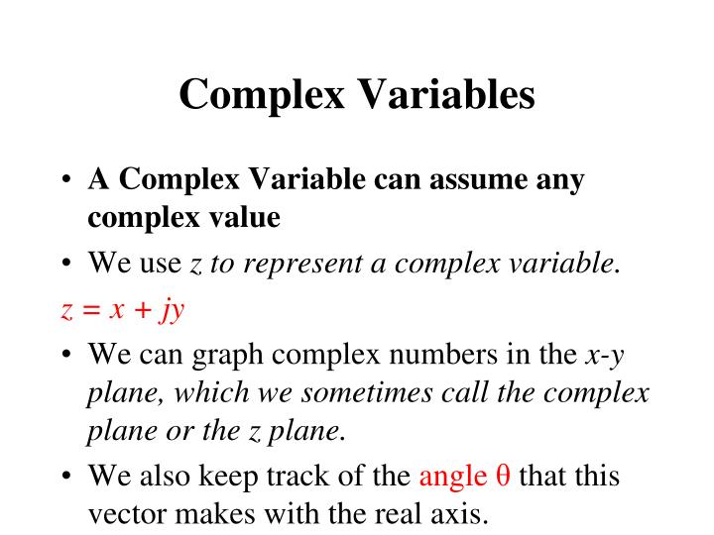

Slide 14
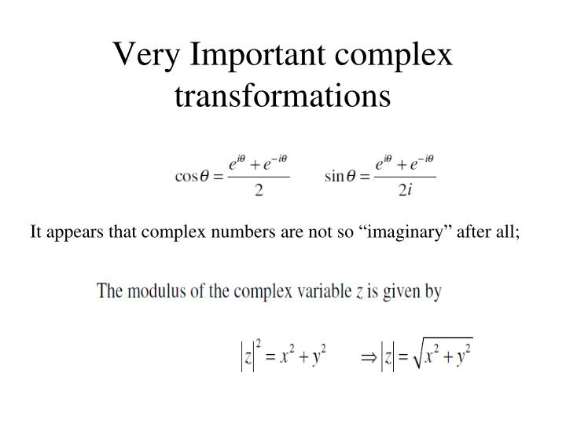

Slide 15
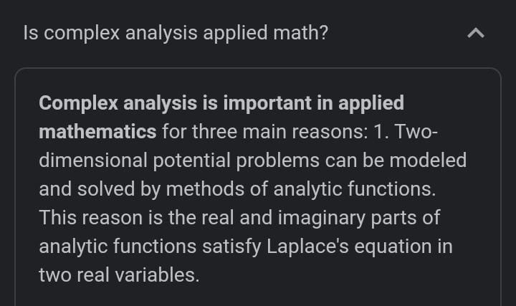

Slide 16
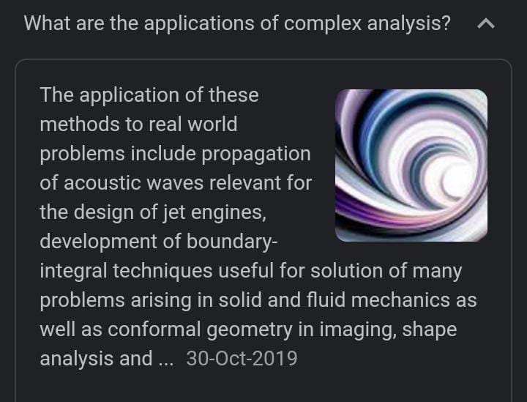

Slide 17
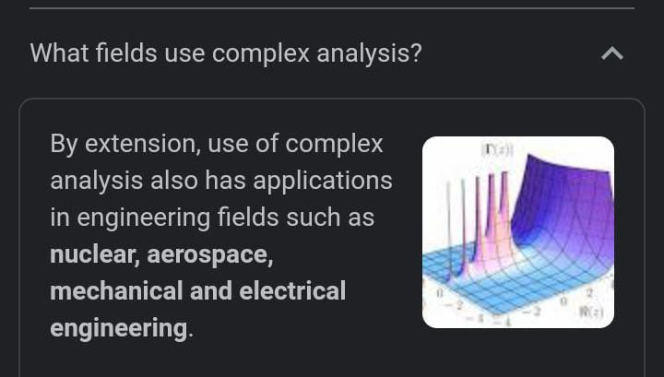

Slide 18


Slide 19


